Slide 1

Note: The data and information in this document is reflective of a hypothetical situation and client. This document is to be used for KPMG Virtual Internship purposes only.
Sprocket Central Pty Ltd
Data analytics approach
[Division Name] - [Engagement Manager], [Senior Consultant], [Junior Consultant]

Slide 2
Note: The data and information in this document is reflective of a hypothetical situation and client. This document is to be used for KPMG Virtual Internship purposes only.
Agenda
Introduction
Data Exploration
Model Development
Interpretation

Slide 3
Note: The data and information in this document is reflective of a hypothetical situation and client. This document is to be used for KPMG Virtual Internship purposes only.
Introduction
Identifying the target customers: What criteria should we use?
Based on the demographic data provided, we can conclude that the majority of customers who have bought a high volume of products over the past 3 years didn’t own a car. We also know that customers who are affluent or have a high net worth are more likely to buy more products and have the capacity to spend more money buying those products. Therefore, we can use wealth segment and car ownership as criteria for targeting high-value customers.

Slide 4
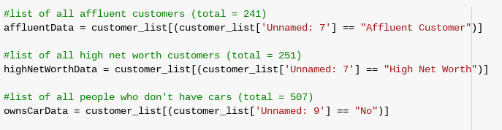
Note: The data and information in this document is reflective of a hypothetical situation and client. This document is to be used for KPMG Virtual Internship purposes only.
Data Exploration
How will we use the identified criteria to isolate target customers?
By isolating customers who meet individual criteria, we can establish a main group to explore further. Within this new group, we can find customers who demonstrate an overlap of criteria.
In our case, we can isolate customers who are affluent, have a high net worth, and don’t own cars. We can then expand on the customers that don’t have cars by exploring which of them are also high net worth or affluent.

Slide 5
Note: The data and information in this document is reflective of a hypothetical situation and client. This document is to be used for KPMG Virtual Internship purposes only.
Model Development
How will we develop a model to identify target customers?
We can use Python and import the pandas and matplotlib packages in order to create these models. We begin by isolating customers by specific criteria alone (see previous slide). We can then expand on the customers who don’t own cars. Within this group, we can identify people who aren’t car owners and affluent or high net worth. This final grouping will serve as a final recommendation as to who, out of Sprocket’s 1000 clients, we should target.

Slide 6
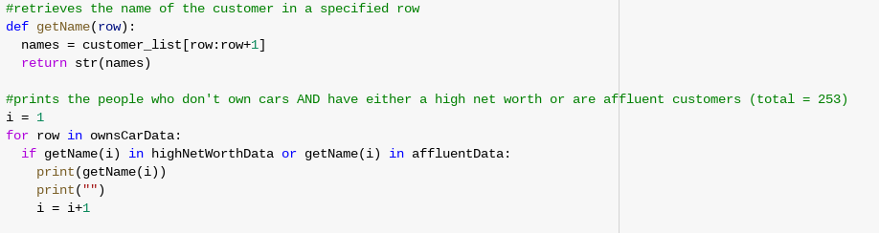
Note: The data and information in this document is reflective of a hypothetical situation and client. This document is to be used for KPMG Virtual Internship purposes only.
Model Development
Here, we have created a function, getName, that retrieves the name of the customer in a specified row. Using this function, we can expand on the group of customers who aren’t car owners (represented by the dataframe titled “ownsCarData”) and see if they overlap with either the group of affluent customers or the group of high net worth customers.

Slide 7
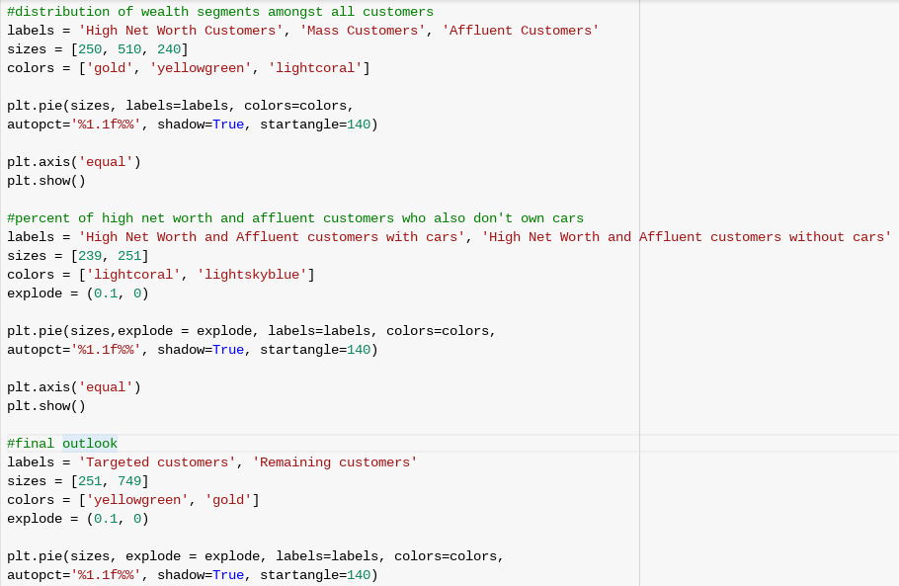
Note: The data and information in this document is reflective of a hypothetical situation and client. This document is to be used for KPMG Virtual Internship purposes only.
Model Development
Python code for pie charts

Slide 8
Note: The data and information in this document is reflective of a hypothetical situation and client. This document is to be used for KPMG Virtual Internship purposes only.
Interpretation
What are the conclusions that can be drawn?
Based on this information, we have determined the exact list of target customers and their met criteria. Through our analysis with python, assisted by the visual components of matplotlib, we can see that these target customers make up roughly the top 50% of 50% of the 1000 customers, or, roughly the top 25% of the 1000 customers. This percent totals to exactly 251 individual customers. We can conclude that targeting these 251 customers would drive the most value for Sprocket Central Pty Ltd.

Slide 9
Note: The data and information in this document is reflective of a hypothetical situation and client. This document is to be used for KPMG Virtual Internship purposes only.
Appendix

Slide 10
Note: The data and information in this document is reflective of a hypothetical situation and client. This document is to be used for KPMG Virtual Internship purposes only.
Appendix
Python Code used for this project - https://colab.research.google.com/drive/1taQ_UkzM8Jnh5kYJQnBhFuJQjTdcFdzW?usp=sharing
Sprocket Central Pty Ltd Dataset - https://docs.google.com/spreadsheets/d/1lyxwabUjf9PutmOVitOjwuSi2zll7exa09PWMSE1rEs/edit?usp=sharing

